Slide 1

Writing in Graduate School
Welcome to the JMSW Program!
Presented by Sarah Hamrick, MSW, JMSW alum
slhamric@uncg.edu

Slide 2
University Writing Centers
UNCG’S Writing Center:
https://writingcenter.uncg.edu/
NC A&T’s Writing Center:
The University Writing Center (UWC) at A&T https://www.ncat.edu/cahss/departments/engl/Undergraduate%20Programs/free-tutoring.html is a space where writers and readers meet. It offers assistance with grammar, mechanics and supports writers throughout the writing process. The UWC is open to students from all programs. This center is located in room A309 in the General Classroom Building (GCB). Opening hours are Monday & Wednesday 10am - 4pm and Tuesday & Thursday 10am - 3pm. Please call 336-334-7764 to set up an appointment.

Slide 3
Let’s Talk about Writing!
How do you think writing in graduate school will be different from writing when you were an undergraduate?
What are you most worried about as far as writing in graduate school? What do you want to know?
What are your writing strengths? Do you like writing? Why or why not?

Slide 4
The Writing Process
What does your writing process look like?
Use what works for you!
Give yourself plenty of time. You want to make sure you have time for editing and revisions
How to get started- understanding the assignment, planning to write
Break things into small pieces

Slide 5
What are my Professors looking for?
Papers with a strong thesis statement that are well organized. Use full sentences and organized paragraphs.
A professional voice/tone. Think about your audience and don’t use jargon or write the way you may text a friend!
Critical thinking skills that are articulated well in your writing. Even if you can articulate your thoughts well verbally, you still need to be able to write about them well.

Slide 6
Back to Basics
Use proper grammar, sentence structure and good transitions
Check your spelling
Edit your work (several times)
Format your work as specified by your professors
Read your syllabus, use any rubrics provided, clarify with your professor if you have questions- break it down by sections
Find someone to read your work and make suggestions!

Slide 7
Strategies to Start
Brainstorming
Active reading (we will come back to this)
Outlining
Making sure you understand the assignment- what kind of writing are you being asked to do?

Slide 8
Active Vs. Passive Voice
http://cwidaho.cc/faq/writing-center/what-are-differences-between-active-and-passive-voice
https://www.youtube.com/watch?v=cOhUmttkt90
If you can insert “by zombies” after the verb, you have passive voice!
Passive Voice: She was chased [by zombies]
Active Voice: Zombies chased [by zombies] her

Slide 9
Thesis Statements
A Thesis Statement…
is a road map for the paper (it tells the reader what to expect from the rest of the paper)
tells the reader how you will interpret the significance of the subject matter under discussion.
directly answers the question asked of you.
A thesis is an interpretation of a question or subject, not the subject itself.
The subject, or topic, of an essay might be World War II or Moby Dick; a thesis must then offer a way to understand the war or the novel.
makes a claim that others might dispute.

Slide 10
Thesis Statements
A Thesis Statement…
is usually a single sentence near the beginning of your paper (most often, at the end of the first paragraph) that presents your argument to the reader.
The rest of the paper, the body of the essay, gathers and organizes evidence that will persuade the reader of the logic of your interpretation.
If your assignment asks you to take a position or develop a claim about a subject, you may need to convey that position or claim in a thesis statement near the beginning of your draft.
The assignment may not explicitly state that you need a thesis statement because your instructor may assume you will include one.
When an assignment asks you to analyze, interpret, compare and contrast, or demonstrate cause and effect, or to take a stand on an issue, it is likely that you are being asked to develop a thesis and to support it persuasively.

Slide 11
Thesis Statements Continued
HOW DO I CREATE A THESIS?
A thesis is the result of a lengthy thinking process. Formulating a thesis is not the first thing you do after reading an essay assignment.
Before developing an argument on any topic, you have to collect and organize evidence, look for possible relationships between known facts (such as surprising contrasts or similarities), and think about the significance of these relationships
Once you do this thinking, you will probably have a “working thesis” that presents a basic or main idea and an argument that you think you can support with evidence. Both the argument and your these are likely to need adjustment along the way.

Slide 12
Thesis Statements Continued
HOW DO I CREATE A THESIS?
Writers use all kinds of techniques to stimulate their thinking and to help them clarify relationships or comprehend the broader significance of a topic and arrive at a thesis statement. It may be helpful to start with the critical thinking exercises.

Slide 13
Thesis Statements (yet again)
HOW DO I KNOW IF MY THESIS IS STRONG?
Do I answer the question? Re-reading the question prompt after constructing a working thesis can help you fix an argument that misses the focus of the question.
Have I taken a position that others might challenge or oppose? If your thesis simply states facts that no one would, or even could, disagree with, it’s possible that you are simply providing a summary, rather than making an argument.
Is my thesis statement specific enough? Thesis statements that are too vague often do not have a strong argument. If your thesis contains words like “good” or “successful,” see if you could be more specific: why is something “good”; what specifically makes something “successful”?

Slide 14
Thesis Statements (yet again)
HOW DO I KNOW IF MY THESIS IS STRONG?
Does my thesis pass the “So what?” test? If a reader’s first response is likely to be “So what?” then you need to clarify, to forge a relationship, or to connect to a larger issue.
Does my essay support my thesis specifically and without wandering? If your thesis and the body of your essay do not seem to go together, one of them has to change. It’s okay to change your working thesis to reflect things you have figured out in the course of writing your paper. Remember, always reassess and revise your writing as necessary.
Does my thesis pass the “how and why?” test? If a reader’s first response is “how?” or “why?” your thesis may be too open-ended and lack guidance for the reader. See what you can add to give the reader a better take on your position right from the beginning.
If there’s time, run it by your instructor or make an appointment at the Writing Center to get some feedback.

Slide 15
Paragraphs
Check out this great source:
https://owl.purdue.edu/owl/general_writing/academic_writing/paragraphs_and_paragraphing/on_paragraphs.html

Slide 16
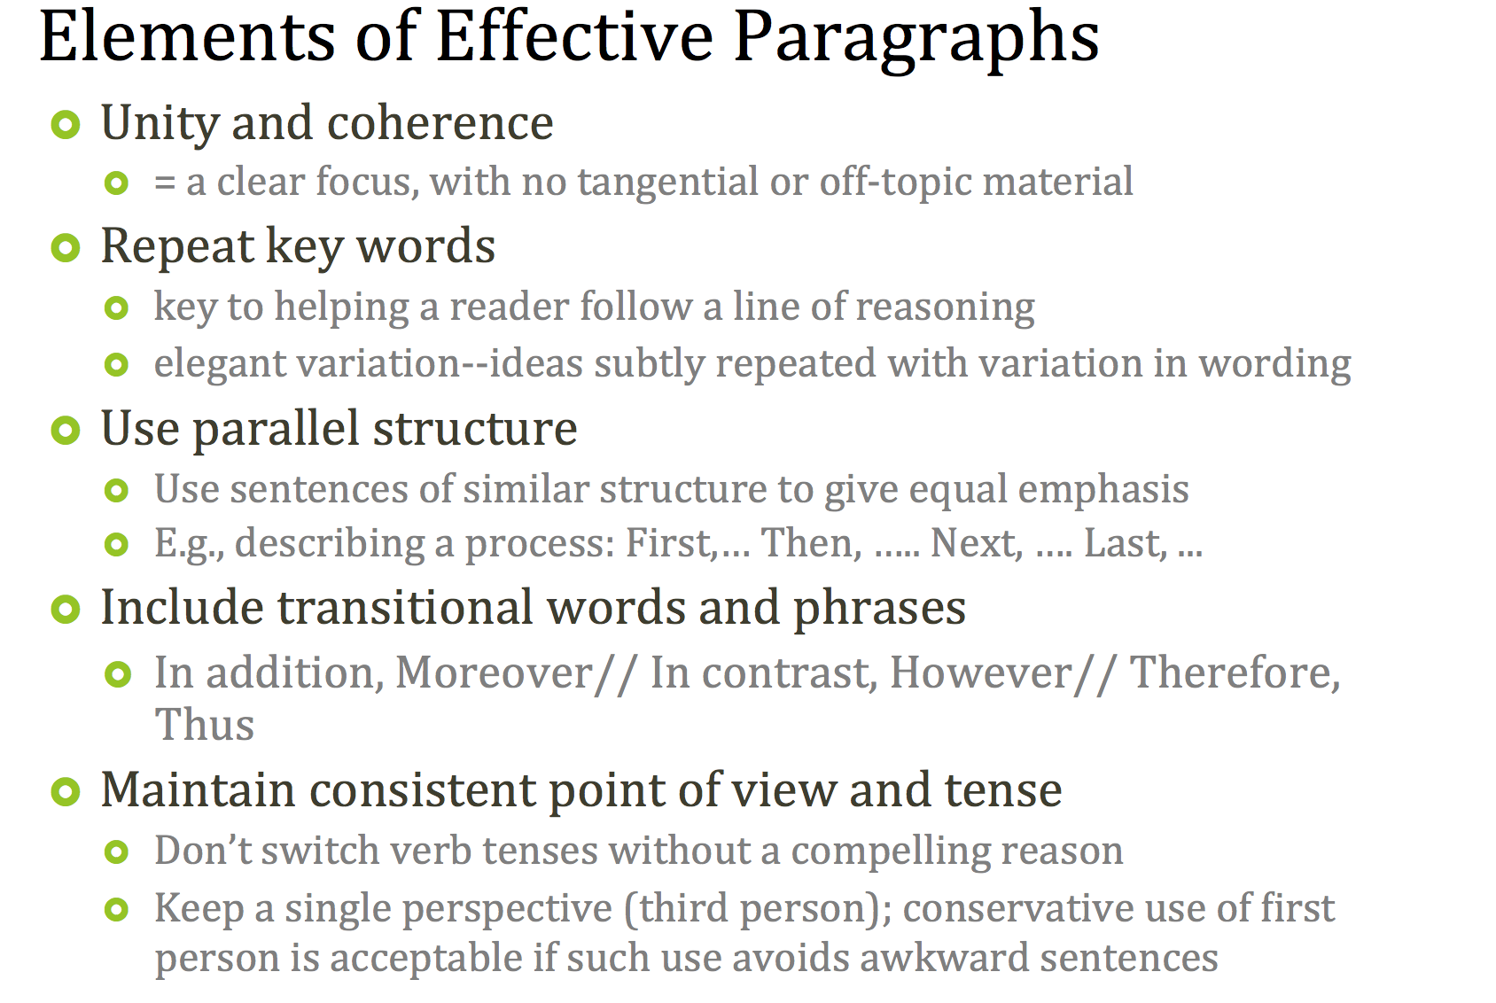
Paragraphs

Slide 17
Overall Organization
As you write, ask yourself the following questions:
Where am I in the outline I laid out at the beginning of the paper?
Am I following the order of headings/topics I laid out?
Do my headings match the topics I said I’d be talking about?
Have I covered each topic I promised to discuss in each section?
How does this paragraph fit in my overall points for this section?
Is it clear how this paragraph follows from the previous paragraph or leads to the
next paragraph?
Have I made all my points? Have I backed up all my points?

Slide 18
Overall Organization
As you write, ask yourself the following questions:
Go through each section to identify the point of each paragraph. Is the point made by each paragraph clear? Does it follow logically in the sequence of points made under the heading? If you are not sure why the paragraph is there or what its point is, your instructor will not know either.

Slide 19
Professional Tone/Voice
We are learning to be professionals, that includes our writing
Don’t write like you text
Consider the assignment and the type of writing it is asking for
Consider your audience
Incorporate your critical thinking skills
https://owl.english.purdue.edu/owl/resource/980/03/

Slide 20
Critical Thinking
Why does it matter?
How is it different that other types of writing?

Slide 21
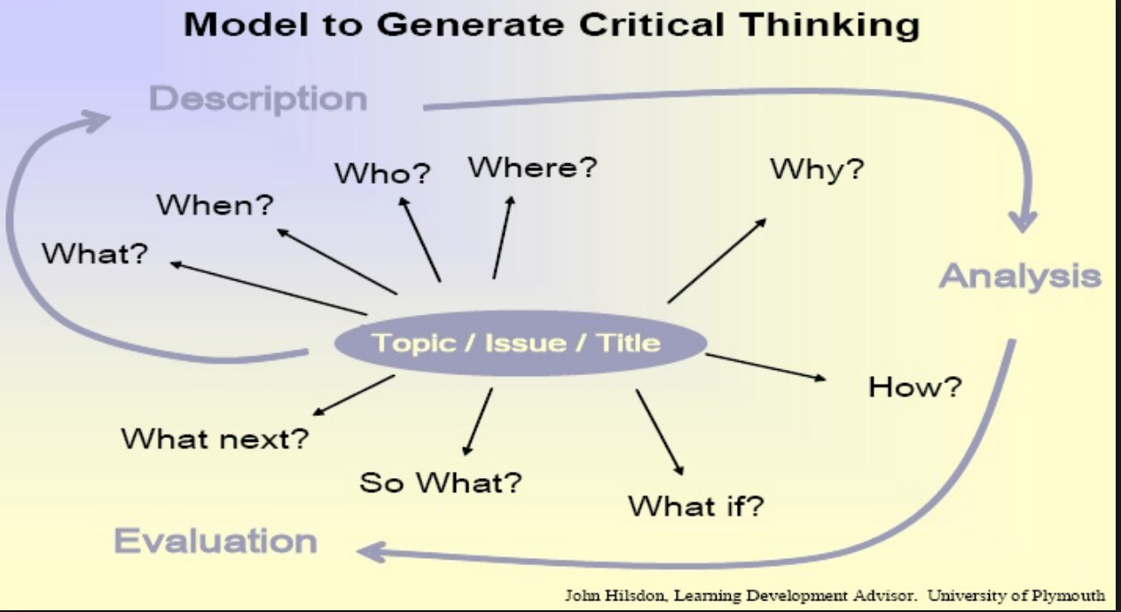
Critical Thinking

Slide 22
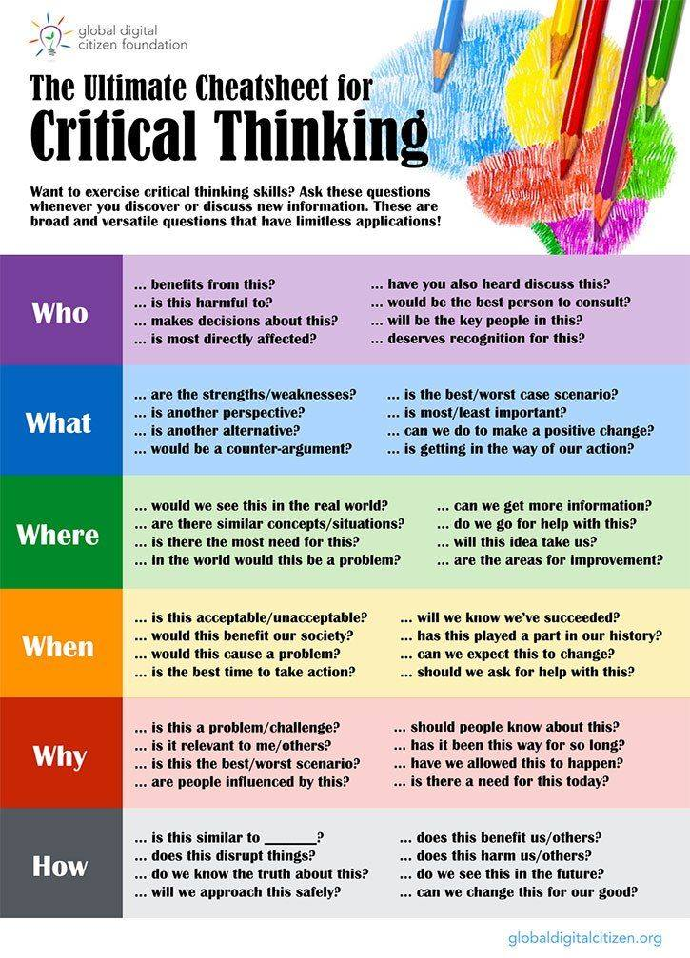
Critical thinking

Slide 23
Descriptive Writing
Descriptive = Book report style
Accurately summarizes and describes
Does not go beyond source content
Represents source “as is” with no added interpretation or discussion
Uses phrases such as “According to...” or “Author said this about that.”
Does not develop an argument but merely lays out information for an argument
The trap of descriptive writing—it is simple to crank out and easy to fill pages with description. Such writing also requires less skill and thought than critical writing.

Slide 24
Critical Writing
Critical Writing = Thoughtful analysis and synthesis
Evaluates validity of evidence/ supports
Offers balanced presentation of validity:
Reasons why the evidence can be accepted
Reasons for caution or limitations
Offers clear presentation of writer’s analysis and position
Does not toss out evidence and assume reader will come to the conclusion the writer expects
Writer guides, directs, and persuades reader to reach the desired conclusion, which is clearly stated

Slide 25
Writing Critically
How to write critically?
Evaluate the quality of your sources (i.e., quality of evidence and argument)
Identify key positive and negative aspects on which you can comment
Assess relevance/usefulness of those points to the argument you are developing in your paper
Identify how your comments can best support your argument and lead reader to accept your viewpoint
Write in your own voice
Remember, the evidence you present is meant to support your position or claim and not the other way around!

Slide 26
What is a credible source?
https://owl.english.purdue.edu/owl/resource/588/02/
Peer reviewed articles
Professional journals
Published books- textbooks, etc
Some websites- NOT wikipedia
Interviews with professionals in the field

Slide 27
Active Reading Skills
Active Reading will help you think and write critically
Respond intellectually as you read
Identify
Evaluate
React
Question
Challenge
Active reading fully engages the mind

Slide 28
Active Reading Continued
Hunting for information as you read
What was objective of study?
What hypothesis was tested?
Were there compelling background elements that justified study?
What were the most important findings?
Why are they important? Consistent? New?
How did results and discussion sections differ?

Slide 29
Active reading continued
Were the conclusions consistent with results/findings?
Any new sources brought to discussion?
What questions emerge from study?
What implications arise from study?
Consistent with others in the field?

Slide 30
Active Reading and Writing As you read
Take advantage of “ah‐ha” moments
If a comparison becomes apparent, pause reading and write those sentences
Reporting answers: Who, What, When, Where, Why, How
Go beyond reporting in your notes by
Noting gaps in the argument
Evaluate argument’s validity
Consider the limitations?
What things did author fail to consider?

Slide 31
APA Style Citation
The JMSW Program uses the APA (American Psychological Association) style of citation.
Get familiar with citation before you have to start using it!
Resources:
https://owl.english.purdue.edu/owl/resource/560/01/
http://uncg.libguides.com/citation

Slide 32
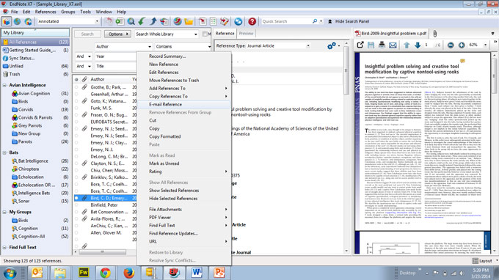

APA Style Citation
There are engines that will create citations for you, but always double check them!
Some programs include
endnote.com/

Slide 33
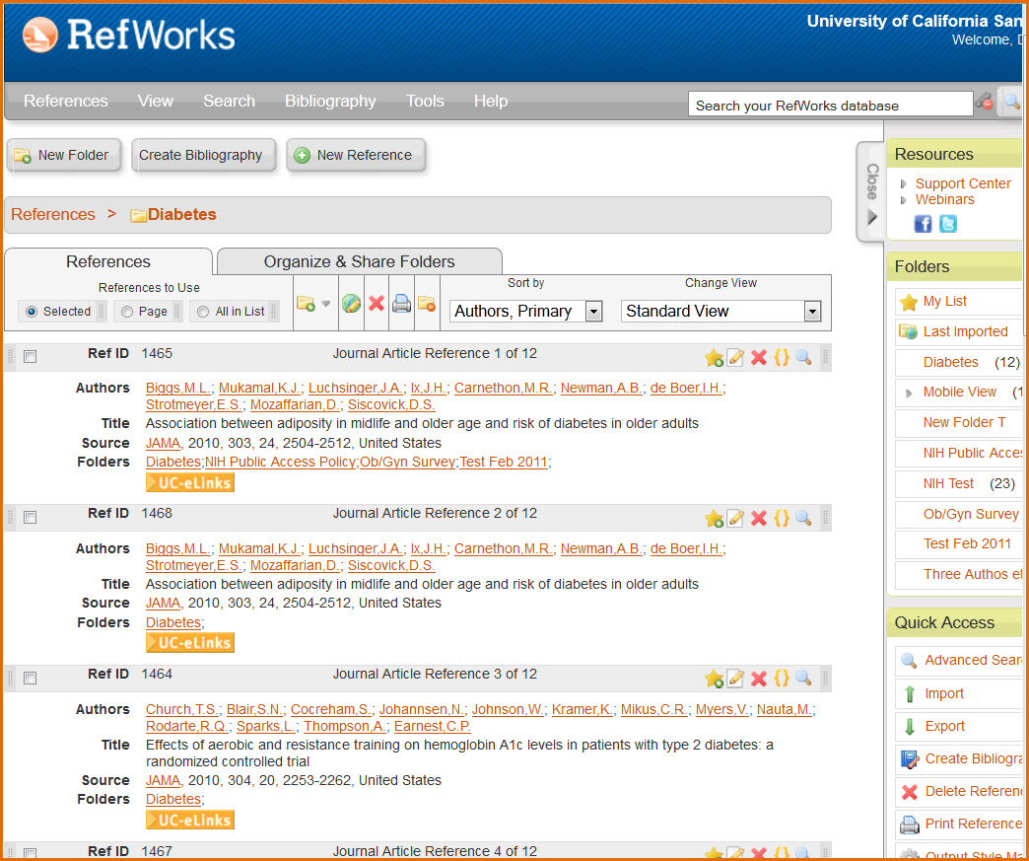

APA Style Citation
There are engines that will create citations for you, but always double check them!
Some programs include
www.refworks.com/

Slide 34

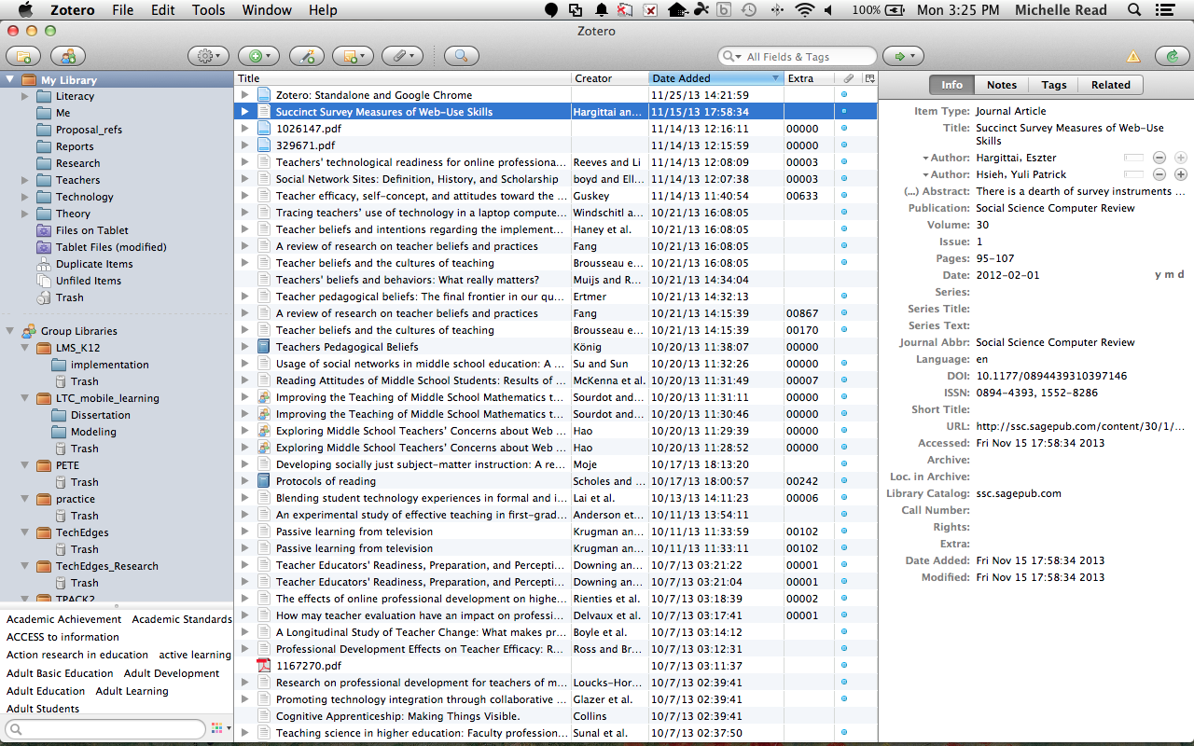
APA Style Citation
There are engines that will create citations for you, but always double check them!
Some programs include
https://www.zotero.org/

Slide 35
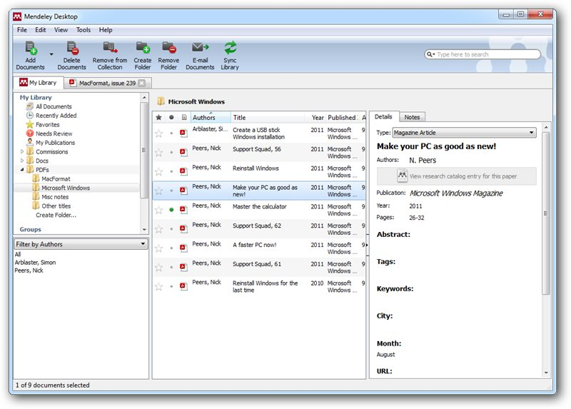

APA Style Citation
There are engines that will create citations for you, but always double check them!
Some programs include
https://www.mendeley.com/

Slide 36
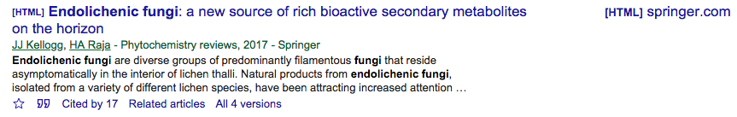
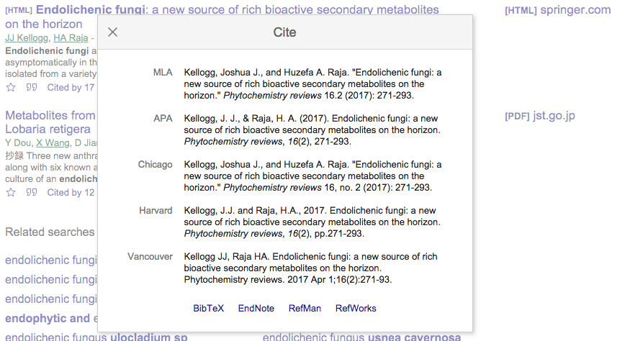
Google Scholar
Enables you to download a reference in any style (including APA)
Will also download into other programs mentioned before

Slide 37
Google Scholar
How to link Google Scholar to UNCG and NCA&T’s library:
https://www.youtube.com/watch?v=5w3KkFRNP1o
How to customize Google Scholar:
http://library.uncg.edu/research/tutorials/video.aspx?f=google1&t=Getting%20Started%20With%20Google%20Scholar:%20Customizing

Slide 38
Don’t Plagarize!
It’s not worth it!
You are smart and have great ideas and contributions- use them!
If you aren’t sure if what you are doing is plagiarism, ask!
There are serious consequences for plagiarism

Slide 39
Reflective Writing
Reflective thinking and writing
a form of personal response to experiences, situations, events or new information.
a 'processing' phase where thinking and learning take place.

Slide 40
Reflective Writing
Reflective writing is:
your response to experiences, opinions, events or new information
your response to thoughts and feelings
a way of thinking to explore your learning
an opportunity to gain self-knowledge
a way to achieve clarity and better understanding of what you are learning
a chance to develop and reinforce writing skills
a way of making meaning out of what you study

Slide 41
Reflective Writing
Reflective writing is NOT:
just conveying information, instruction or argument
pure description, though there may be descriptive elements
straightforward decision or judgement (e.g. about whether something is right or wrong, good or bad)
simple problem-solving
a summary of course notes
a standard university essay

Slide 42
How do I write reflectively?
How you:
solved a problem / reached a conclusion / found an answer
reached a point of understanding
Possibilities, speculations, hypotheses or solutions
Alternative interpretations or different perspectives on what you have read or done in your course
Comparisons and connections between what your are learning and:
your prior knowledge and experience
your prior assumptions and preconceptions
what you know from other courses or disciplines
How new ideas challenge what you already know
What you need to explore next in terms of thoughts and actions

Slide 43
Reflective Writing
As it concerns your thoughts, reflective writing is mostly subjective. Therefore in addition to being reflective and logical, you can be personal, hypothetical, critical and creative. You can comment based on your experience, rather than limiting yourself to academic evidence.
Reflective writing is an activity that includes description (what, when, who) and analysis (how, why, what if). It is an explorative tool often resulting in more questions than answers.

Slide 44
Reflective Writing
A reflective task may allow you to use different modes of writing and language:
descriptive (outlining what something is or how something was done)
explanatory (explaining why or how it is like that)
expressive (I think, I feel, I believe)
Use full sentences and complete paragraphs
You can usually use personal pronouns like 'I', 'my' or 'we'
Keep colloquial language to a minimum

Slide 45
Reflective Writing Tips
Tips to help you in your reflective writing process
Think of an interaction, event or episode you experienced that can be connected to the topic
Describe what happened
What was your role?
What feelings and perceptions surrounded the experience?
How would you explain the situation to someone else?
What might this experience mean in the context of your course?
What other perspectives, theories or concepts could be applied to the situation?

Slide 46
Research Opportunities
Seek out mentors in the field that do what you want to do
Encourage the JMSW Program to inform you of research opportunities
This is graduate school- dive into research now- you may not get the chance again!
Think about participating in the Graduate Expo at UNCG:
https://grs.uncg.edu/grc-expo/
NCA&T may also offer one- check their website!

Slide 47
Final Thoughts
You can do this!
You already have writing skills- build on them!
Ask for help when you need it
Start early, avoid procrastination
Use your resources on both campuses and online! Many universities offer free online resources- UNC’s is amazing- see below!
https://ssw.unc.edu/students/writing

