Slide 1

National Association of Social Workers
North Carolina Chapter
Angel Webster
2nd Year JMSW Student
NASW-NC Graduate Student Representative
JMSW/NASW Student Liaison
JMSW Student Org Advocacy Coordinator

Slide 2
NASW-NC Mission Statement and Vision
Mission: “NASW is a membership organization that promotes, develops and protects the practice of social work and social workers. NASW also seeks to enhance the effective functioning and well-being of individuals, families and communities through its work and through its advocacy”.
Vision: “To be a vital part of every professional social worker in North Carolina”.

Slide 3
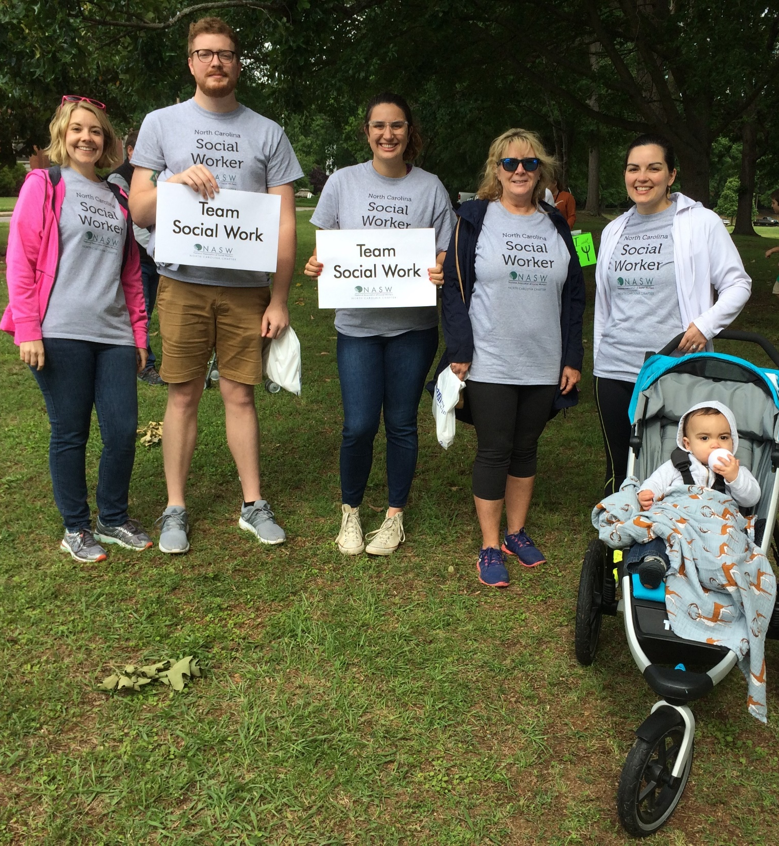
NASW History and Membership
Founded in 1955
The largest membership
organization of professional social workers in the world
125,000 members
55 chapters

Slide 4
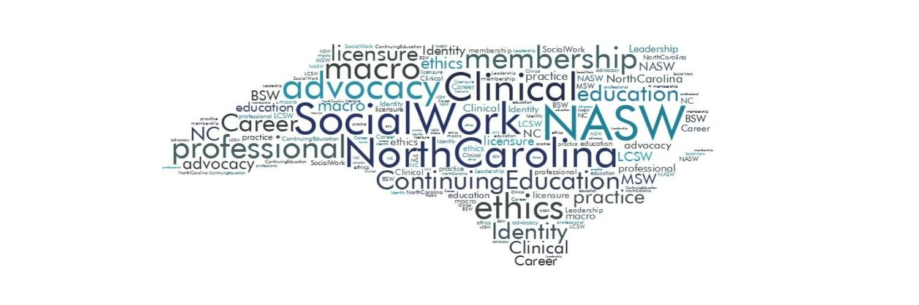
NC Chapter History and Membership
4,600+ members, 240+ international
7 Conferences and Networking Opportunities
15 Local Program Units
Practice Area Networks (Clinical, LGBTQ, Military, School SW, Integrated Care, Macro…)
Leadership Opportunities

Slide 5
Top 5 Reasons to Join NASW-NC
1) Professional development resources
2) Insurance & risk management resources
3) Networking
4) Advocacy
5) Discounted membership rates

Slide 6

Membership Dues
Student Membership Dues
Regular membership Dues
BSW: $57 a year
MSW: $57 a year
Doctoral: $170 a year
Transitional: First year $110
Second year $110
Third year: $170
BSW: $150 a year
Regular: $225 a year
Unemployed, Retired and Hardship: $70 a year

Slide 7
Cost of Your Education and Licensure
MSW Degree at UNC Chapel Hill
2 Years Tuition ≈ $32,024 - $65,946
Licensure
Application: $115
Renewal: $140-150
100 hours of Clinical Supervision: $5,000+
ASWB Clinical Exam: $40 processing fee + $260 exam fee
40 hours of CEU’s every 2 years: $150-$600 (NASW members have access to free and discounted CEU’s)
Total ≈ $5,750 – $6,165
Total = $37,774 – $72,111+

Slide 8
Local Program Units and Continuing Education Units
LPU’S:
15 Units in the State
Local Units in Guilford County and Forsyth County
At UNCG: Jennifer Cobb-Guilford LPU
Michael Thull-Forsyth LPU
CEU’S:
Classes are open to both members and non-members
Members receive discounted rates on classes
You do not have to have a license to attend, but a license is needed to obtain continuing education credits

Slide 9
Upcoming CEU Events
Guilford
Forsyth
4th Saturday of each month
10am-12:30pm
$30 non-members
$10 members
Next Class: August 25th
GCSTOP: “Meet Me Where I Am”
Free for members
$30 non-members
Next Class: October 6th
Forsyth Tech Community College
9:45am-12pm
“Sex offender treatment in civil confinement”

Slide 10
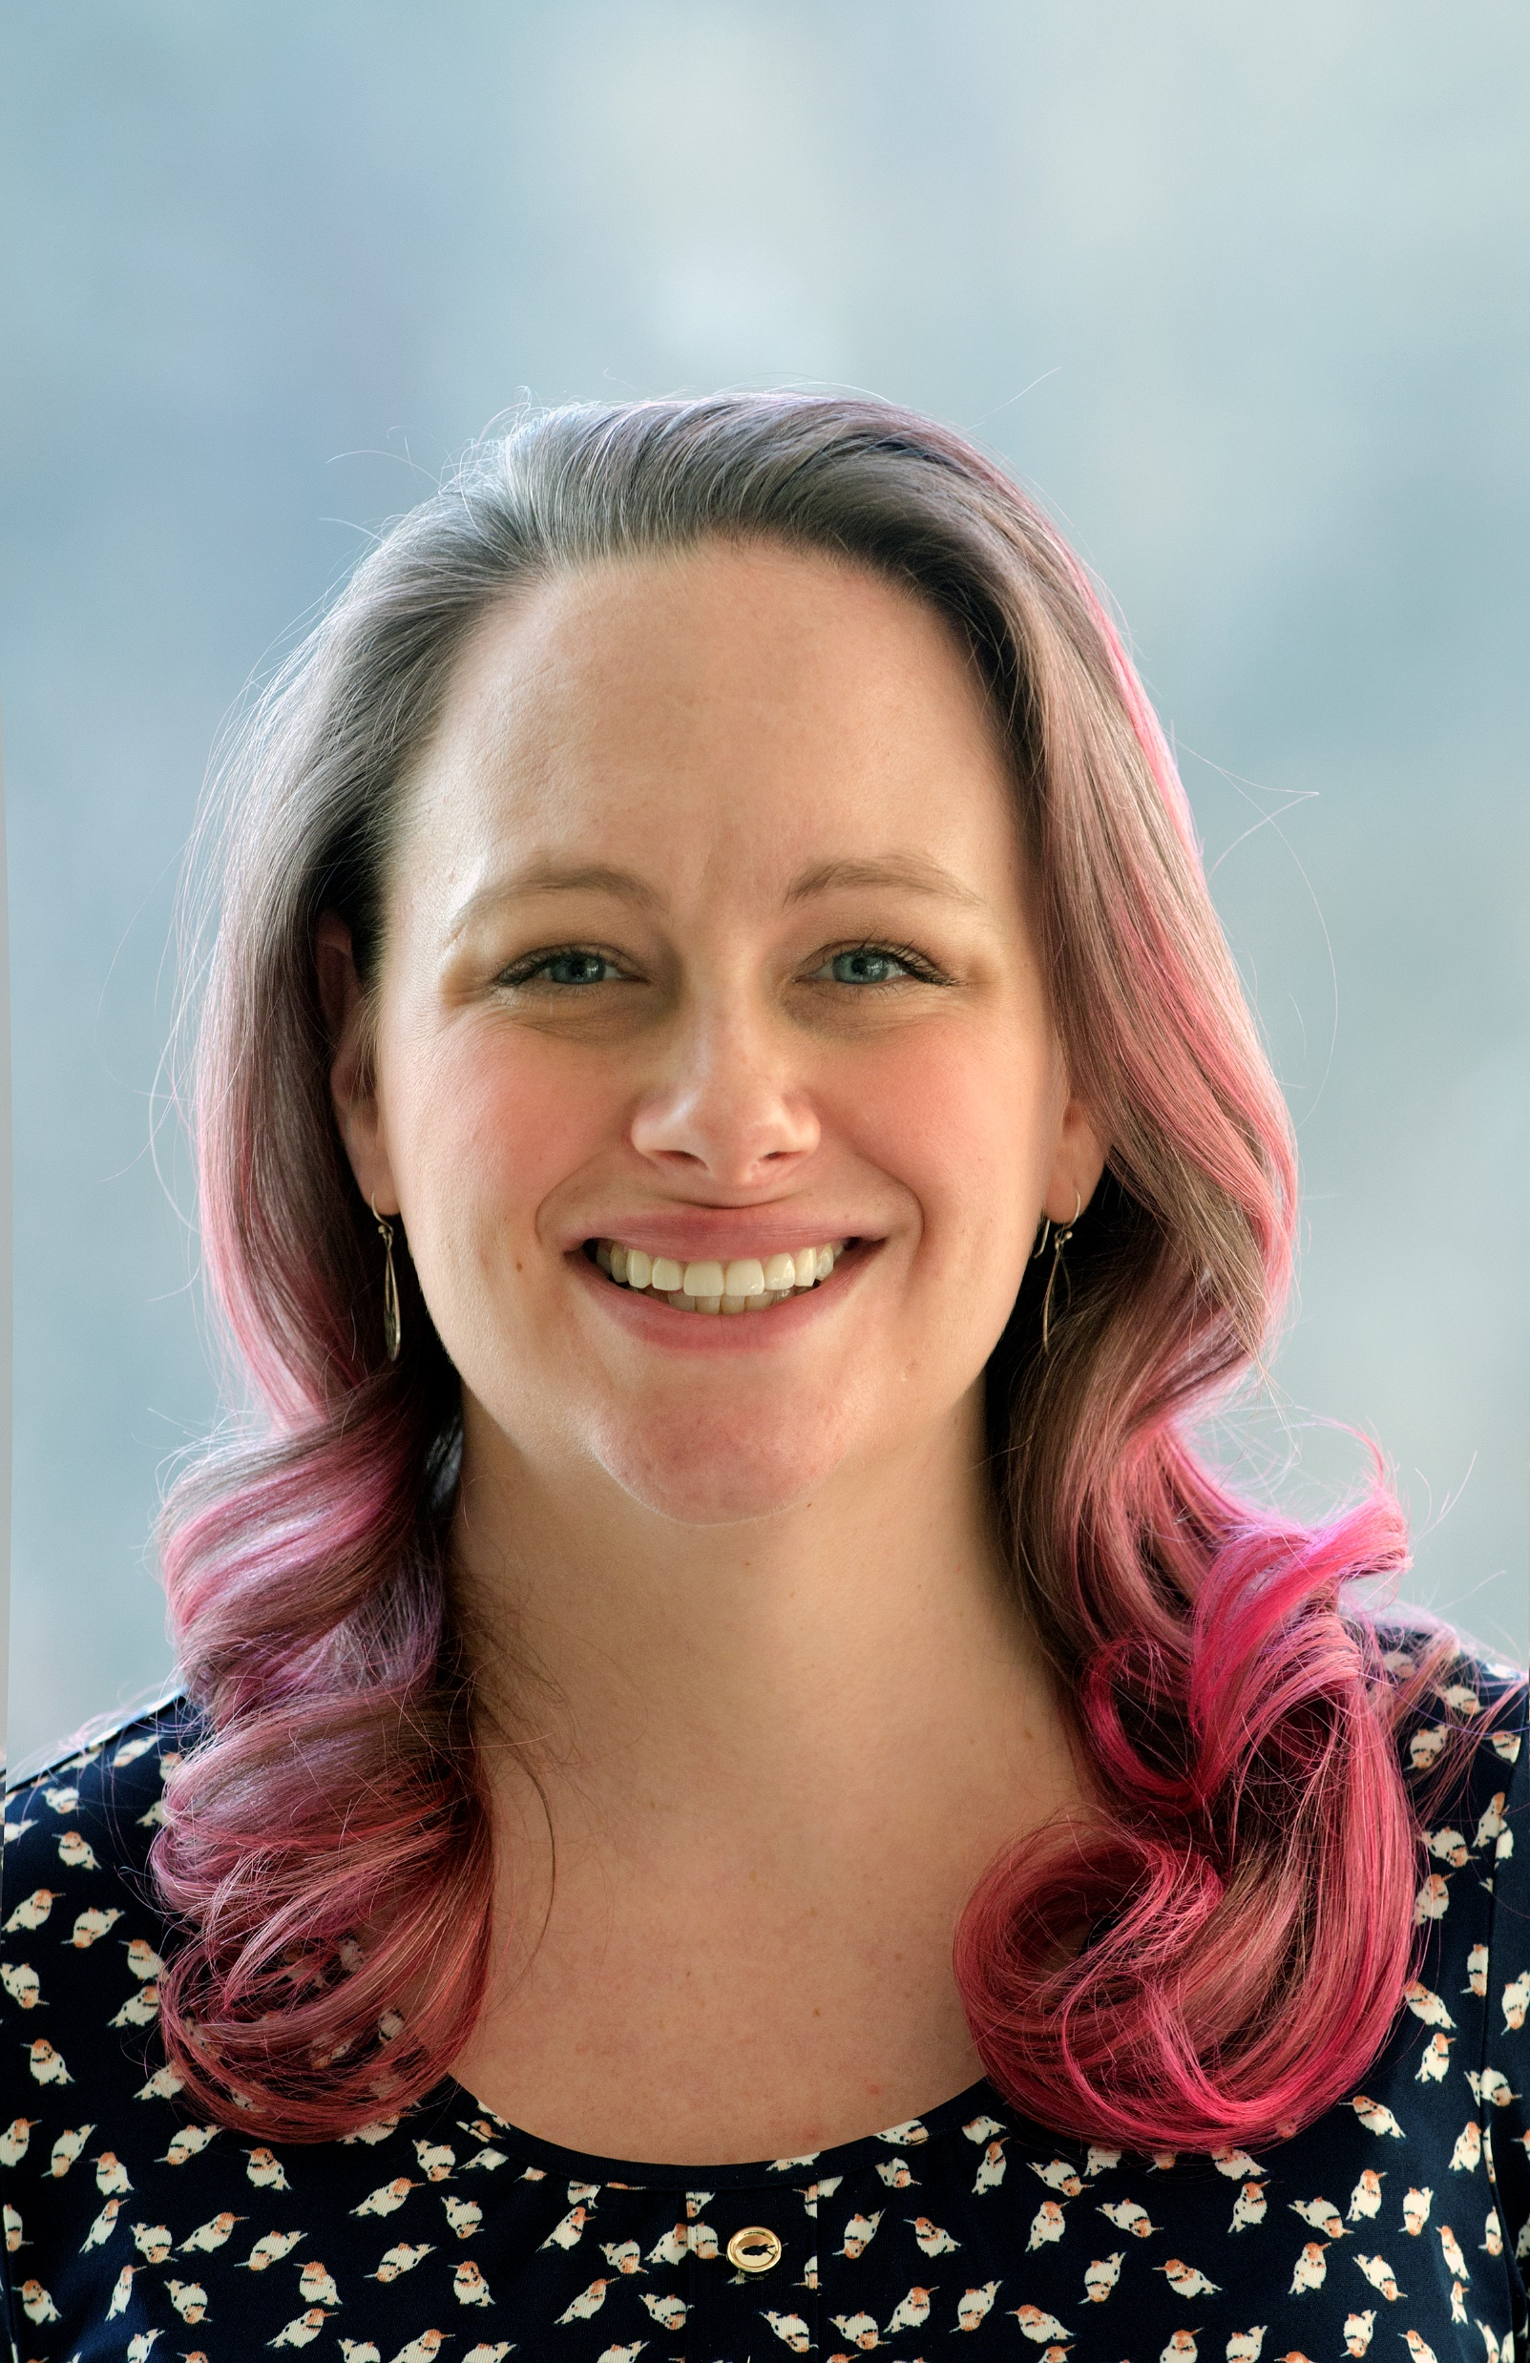
Scholarships and Awards
Social Worker of the Year
Myrna Miller Wellons Advocacy Award
Conference Scholarship Award
Presidents Award, $1000 awarded to an MSW Student
Recent winner from JMSW Program
Winners in past years 2008, 2009, and 2011

Slide 11
Other Member Benefits
A free research library to member – 25 International databases
Access to the Code of Ethics
Step-by-step advice on how to connect with legislators
List of lobbying Do’s and Don’ts
Membership fees are not tax deductible
Donations ARE tax deductible and 100% of all donations goes towards awards and scholarships
Information on loan repayment and forgiveness
Loan options for pursuing a social service profession
Listings of internet scholarship search engines
Fall Exam Prep: October 27th, 10am, $99 for members, register by 10/5/18

Slide 12

How Do I Join?
Contact
Seth Maid, MSW
Director of Membership and Communication
membership.naswnc@socialworkers.org
Or visit
https://www.naswnc.org/default.aspx

Slide 13


Stand up with us and become a member of NASW, YOUR professional social work association!
JOIN TODAY!
socialworkers.org

